Slide 1
IBM University Engagement Project Submission
“Exploring the Power of Machine Learning with IBM Cloud”

Slide 2

Project Tile – RAG Based AI Tutor Chatbot
Domain of Project – AIML, Educational Technology(EdTech)
Student Name | Recent Passport Photo | Email ID | Mobile number [WhatsApp]
Pulkaram Dharani |  | dharanipulkaram3 @gmail.com | 9182894310

Slide 3
Problem Statement -
Problem Statement: SmartEdu – RAG Based AI Tutor Platform
The rapid growth of digital education has increased the need for intelligent learning systems that provide accurate and personalized academic support. Students often spend significant time searching through lecture notes, PDFs, PPTs, and other study materials to find relevant information. Traditional AI chatbots rely on pre-trained knowledge and may generate inaccurate or syllabus-independent responses, reducing the reliability of learning. Faculty also face challenges in managing and organizing educational resources for students. The task is to design, develop, and evaluate a Retrieval-Augmented Generation (RAG) based AI Tutor Platform that enables faculty to upload subject-specific study materials and allows students to receive accurate, context-aware answers, quizzes, and summaries based only on faculty-approved content. The goal is to create a reliable AI-powered educational platform that enhances learning efficiency, improves academic support, and provides personalized assistance for students in modern educational institutions.

Slide 4
Proposed Solution -
We propose an AI-powered SmartEdu Tutor Platform using Retrieval-Augmented Generation (RAG), Google Gemini, FAISS, FastAPI, and React.
Faculty members upload subject-specific study materials such as PDF, PPTX, and DOCX files through the platform.
The uploaded documents are processed using text extraction, chunking, embedding generation with Sentence Transformers, and FAISS vector indexing to build subject-wise knowledge bases.
Students select a subject and submit academic queries through the AI Tutor interface.
The RAG pipeline retrieves the most relevant content from the selected subject, and Google Gemini generates accurate, context-aware responses based only on the retrieved faculty-approved materials.
The platform also supports quiz generation, summary generation, chat history, and role-based access for Students, Faculty, and Administrators, providing a secure and personalized learning experience.

Slide 5
Technology Used
IBM Cloud – It provides the infrastructure to build, deploy, and scale the Nutrition Agent efficiently. IBM Cloud enables a reliable, secure, and scalable environment for deploying the Nutrion agent
ML Algorithm/ Model Used: Retrieval-Augmented Generation (RAG), Sentence Transformers, Google Gemini
Accuracy Obtained: High Retrieval Accuracy and Context-Aware Response Generation
Enhancements and Hyperparameter tuning: FAISS Vector Indexing, Optimized Document Chunking, Semantic Embeddings, Prompt Engineering

Slide 6
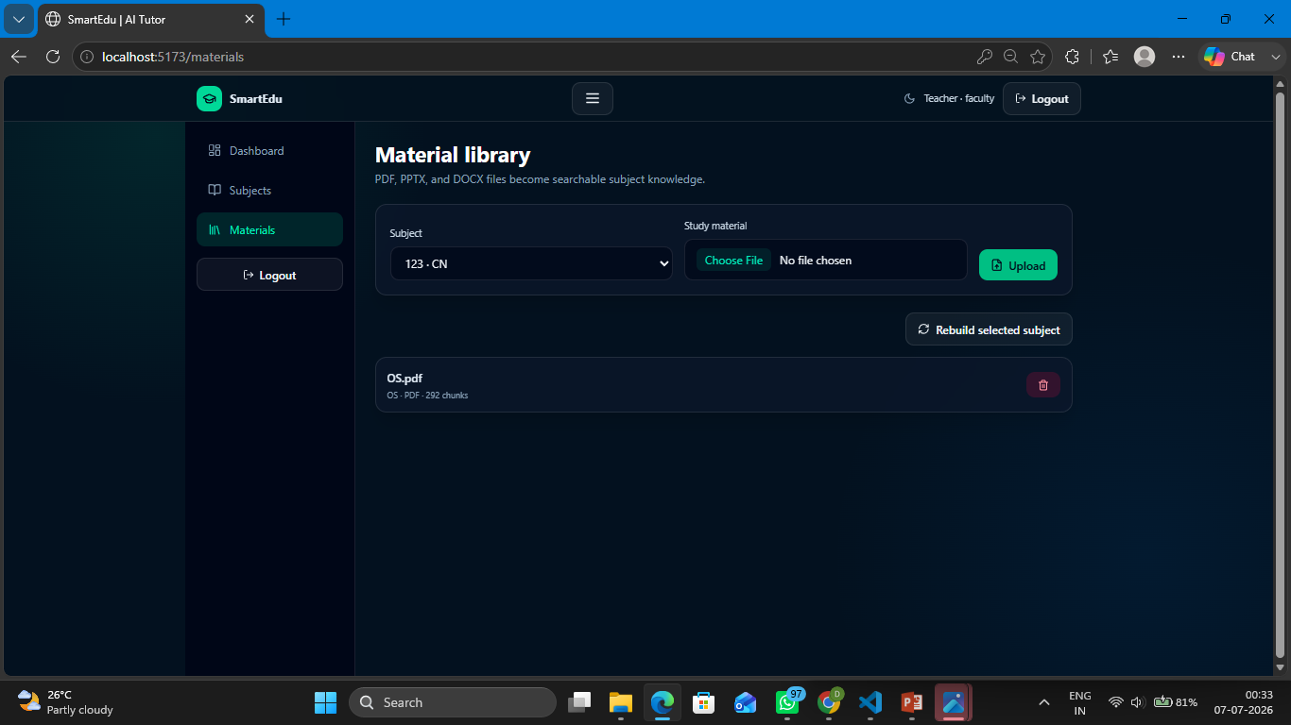
Training Screenshots-

Slide 7
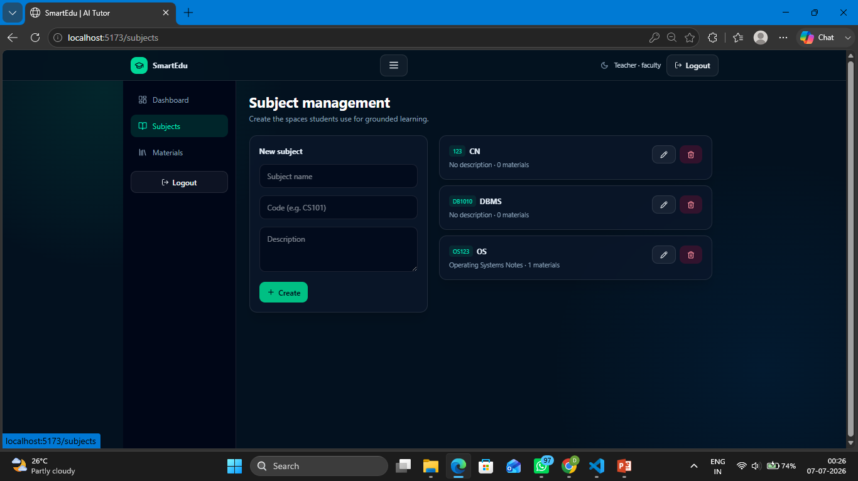
Training Screenshots-

Slide 8
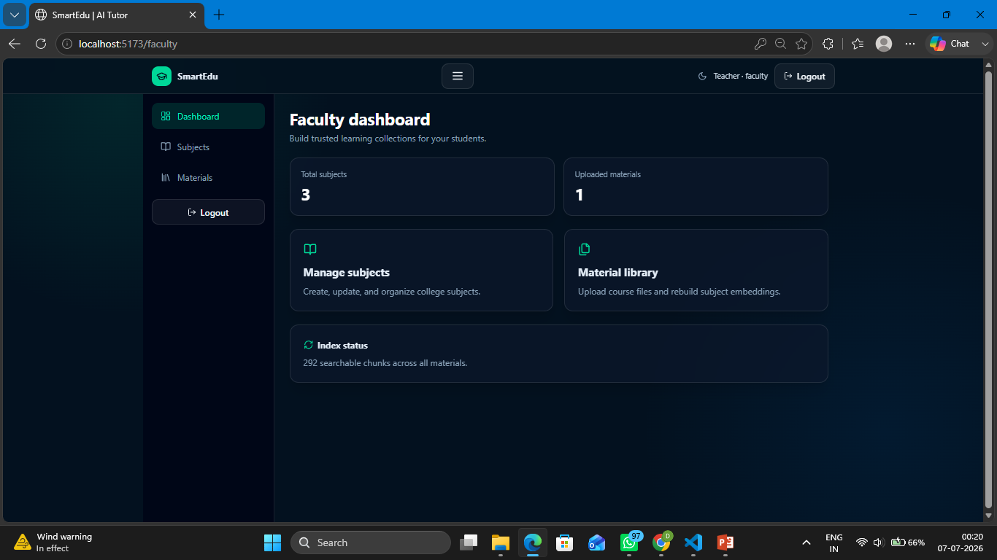
Best Model Screenshot:

Slide 9
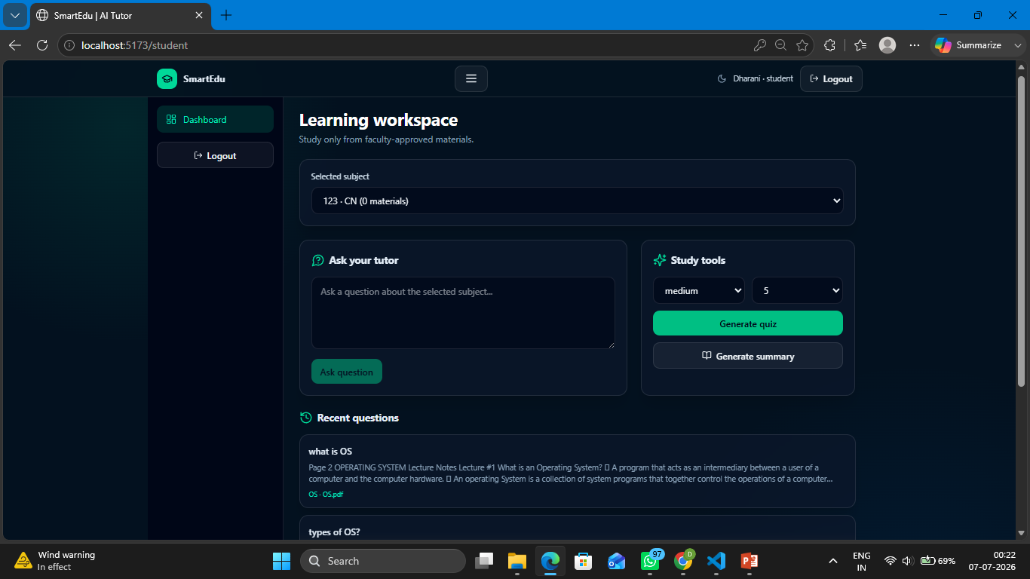
Testing Screenshot:

Slide 10
Novelty and Uniqueness
The proposed system provides accurate, context-aware answers by combining Retrieval-Augmented Generation (RAG) with Google Gemini, reducing inaccurate or hallucinated responses.
It enables faculty-managed knowledge bases, allowing teachers to upload and organize subject-specific study materials for students.
The platform performs subject-wise semantic retrieval using Sentence Transformers and FAISS, ensuring responses are generated only from the selected subject's learning resources.
It integrates AI-powered quiz generation, summary generation, and chat history within a single educational platform, enhancing the overall learning experience.
The system implements role-based access control for Students, Faculty, and Administrators, providing secure content management and personalized academic assistance.

Slide 11
Git Hub Link
Github URL – https://github.com/DharaniPulkaram7/RAG-Based-AI-Tutor-Chatbot.git
·
·
·

Slide 12
Future Scope
The platform can be integrated with Learning Management Systems (LMS) such as Moodle and Google Classroom to provide seamless access to course materials.
Support for multilingual tutoring and voice-based interaction can be added to make
the system accessible to a wider range of students.
Advanced AI models can be integrated to provide personalized learning recommendations, adaptive quizzes, and performance-based study plans.
Real-time analytics and student progress tracking can be incorporated to help faculty monitor learning outcomes and identify students requiring additional support.
The platform can be deployed across multiple educational institutions as a scalable cloud-based AI learning solution, enabling secure and efficient digital education.
·
·
·

Slide 13
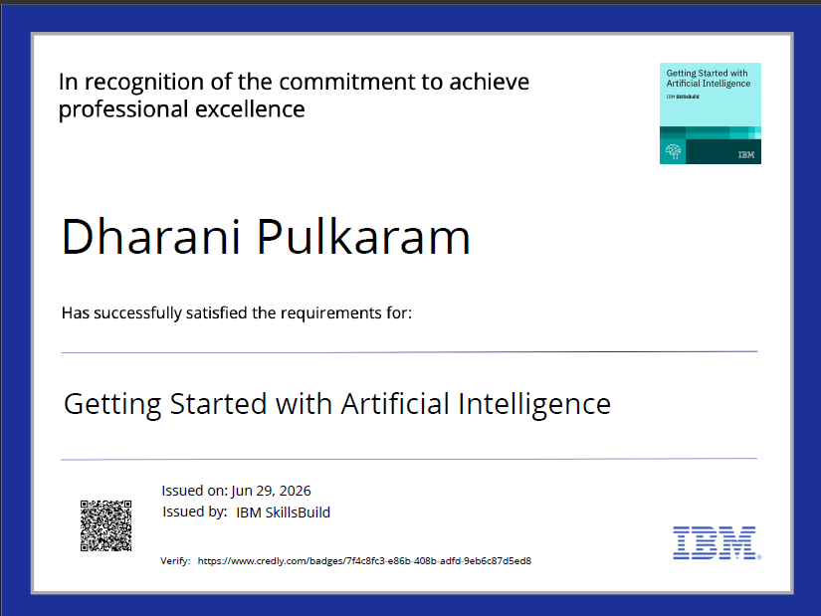
Certificates Earned:
Please add your credly certificate

Slide 14
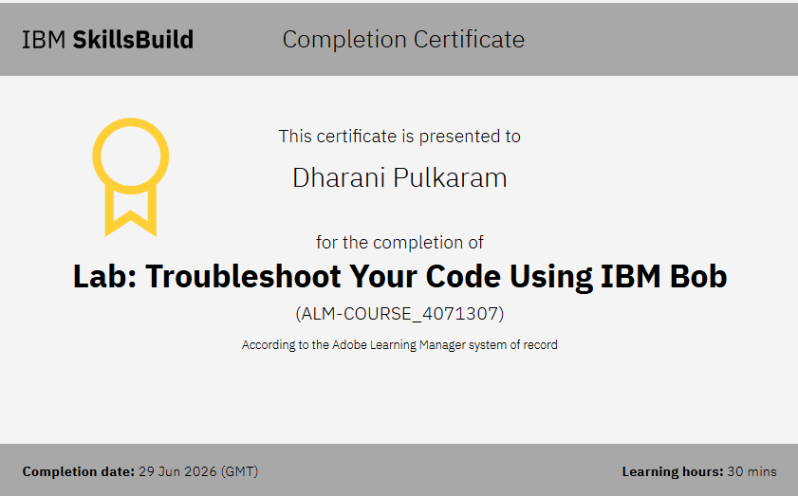
Certificates Earned:​
Add your IBM BOB Certificate

Slide 15


